Slide 1
Power Point Presentation
Topic Of Irony/Humor
Samantha Ligols

Slide 2
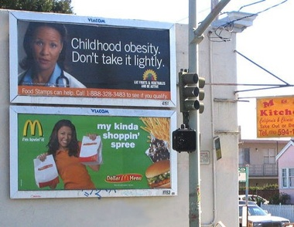
Photographer: Unknown

Slide 3
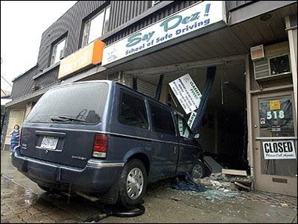
Photographer: Unknown

Slide 4
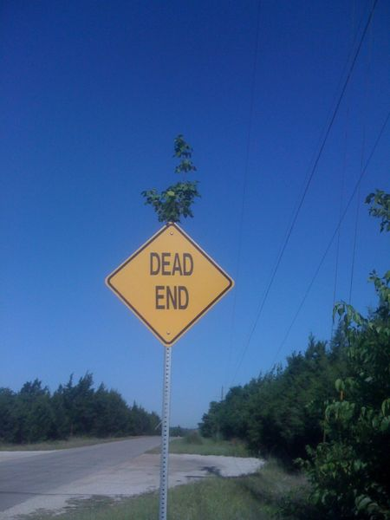
Photographer: Unknown

Slide 5
Photographer: Unknown

Slide 6
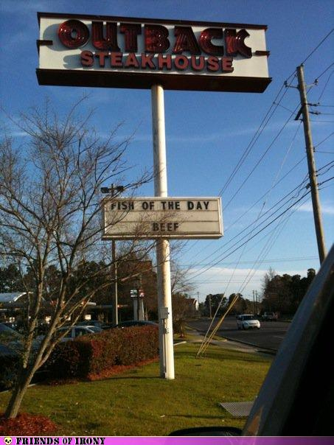
Photographer: Unknown

